Slide 1
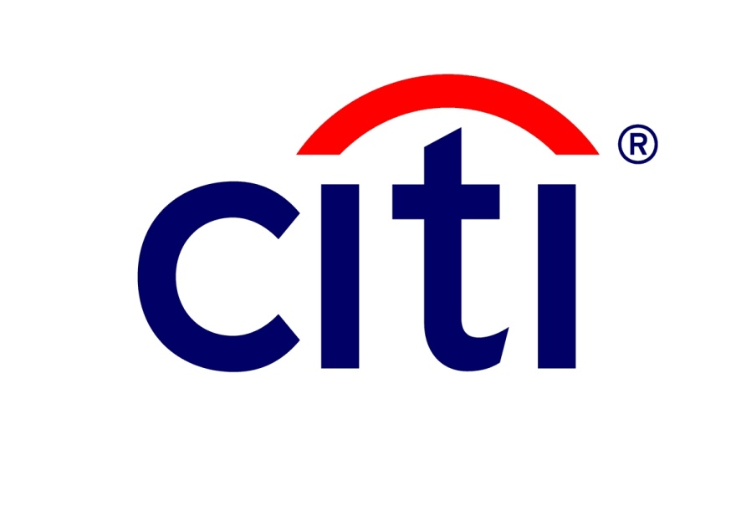
Code Quality
Colin Murphy

Slide 2

Agenda
Introduction & Background
Code Quality
Code Best Practices & Static Code Analysis
Unit Testing & Code Coverage
Continuous Integration
Notes:
Welcome Citi lectures.

Slide 3
Introduction & Background

Slide 4
Introduction & Background
Colin Murphy
Citi Belfast 2012 – Present, Applications Development
Rates Technology
10+ Years Software Development Experience

Slide 5
Code Quality

Slide 6
Code Quality
Code Quality = Software Quality
Focussed on ensuring code is clear & complete
Clarity
Follows set Standards & Practices
Minimize Complexity
Appropriately Documented
Completeness
Unit Testing – testing code in isolation
Quality Assurance
Functional Testing
Non-Functional Testing (e.g. Performance, Look & Feel)
Notes:
Clarity = Maintenance
Developing well is only part of the job, you’re one of many contributors and your coding style should reflect that – code that’s easy to read, and clear about what its doing
Practices –
Static analysis -
Completeness = Right
Does it do what its intended to do? is it performant?
In our case we’re focused on the code level, we’re geeks
Unit Testing –
Quality Assurance -

Slide 7
Meaningful Metrics
Unit Tests
Number
Pass Rate %
Code Coverage %
Static Analysis
Complexity
Average Lines per Class
“Rule” Compliance %
Notes:
Objectively measuring code
It’s difficult, “good” code is a subjective thing
Focus on the quantifiable aspects of the code
Unit Testing – do they all pass? Are you testing the full codebase?
Complexity – Functional Complexity, nesting of ifs/loops/etc.
Lines Per Class – Rough guide to “single purpose”
‘Rule’ Compliance – Static Analysis

Slide 8
Coding Best Practices

Slide 9
What is it?
“Best Practice” – an approach that consistently produces better results than alternatives
In this case producing “better” code – clarity, maintainability, performance, etc..
Best Practice Guidelines (the “What”)
Coding Best Practice
Security Best Practice
Threading – Managing Parallel Code Execution
GUI Layout
Best Practice Processes (the “How”)
Code Review
Source Control
Continuous Integration
Notes:
During project initiation project Best Practice should be drawn up for the team.
These are a set of common guidelines the development team should meet.
They consist of best practice guidelines for Coding and then processes that will help the development life cycle.

Slide 10
Levels
Different Levels of Organisation
Company -> Project -> Component -> Etc.
General Practices at Company Level, More specific at Lower Levels
As the focus narrows the exact concerns are better known
Practices can be tailored to the specific concerns
Different functional areas
Performance – e.g. mandating use of “Caching” products
Threading – e.g. mandating use of Java “Executor” libraries
Security – e.g. mandating use of SSL (Secure Sockets Layer) Encryption
Etc.
Notes:
These best practices may well be drawn from a number of different levels from within the company.
A company will provide a set of company-wide best practice to make sure that the company is not exposed to security issues.
Also companies will have best practice for messaging etc.
Projects may consists of different components developed in different languages. This may mean that a project may define standards or override company-wide standards and specific application ones may be defined to meet a language or application needs.

Slide 11
Why?
Developers understand employer/client expectations
Quite often ties into the Non-Functional Requirements (e.g. security, performance)
New Joiners can adapt quickly to the team’s approach
Produced code has a common look and feel
Different developers may have different style preference
A common look and feel helps with
Version Control – no “reformatting” changes
Managing Code Conflicts
Notes:
Standards are important for development teams so that developers understand what is expected of them.
This will aid the speed that new joiners can understand the code. Since the code will not have a mix of styles. I have seen from experience that without standards there are two different types of developers,
Ones that will just copy the style that is in the specific class. So may use different standards depending upon the code they are editing.
Other will use their preference.
Within large applications internal frameworks exist where common threading, exception handling API’s are designed but not documented formally. But these should be noted within the best practice to allow for the long term maintenance of code. Without this multiple API’s will be deployed, due to the size of the code base, since you cannot fully understand and know a million line code base.

Slide 12
Code Review
What is a Code Review?
Evaluation of code by 1 or many peers against defined standard
Also includes a check for correctness
Types
Formal
Group of developers get together to do the review
Lightweight
Ad-hoc Review
Review using tools
Pair Programming
Notes:
Overview of how code review can be carried out.
Larger teams will generally be used for review of major functionality.

Slide 13
Code Review : Standards
Establish Goals for Code Review
Improve Quality of the code produced by development
What Goals/Metrics
How many reviews have taken place
Defect Rate – how many defects per review
Defect Density – defects per lines of code
Types of Defect
Severity - Minor, Major, etc
Area of Application – UI, Server, Persistence Layer, etc.
Impact – Correctness, Performance, etc.
Ensure that reviewers review in advance to keep meetings short
Focus the meeting on cataloguing & discussion of points
Notes:
Important not to impose a process without measuring that it’s a success.
By doing this it can improve the process and guidelines so that only items that will improve quality remain.
Improving quality will include reducing defects found in User Acceptance Testing (UAT) and Production, but this can be difficult to measure.

Slide 14
Example Code Review Checklist
General | Yes/No
Does the code meet the requirement?
Does the code implement more than the requirement?
What testing has taken place to prove that it meets the requirement?
Variable and Constant Declarations
Are the Coding and Naming conventions followed?
Are the names used conveying how they are used?
Are all variables correctly typed?
Are all variables correctly initialised?

Slide 15
Example Code Review Checklist (continued)
I/O | Yes/No
Have all files been opened before use?
Are the attributes used to open the file correct for its usage?
Have files been closed after usage?
Control Flow
For loops is the best construct being used?
Will all loops terminate?
When there are multiple exist points from a loop, are they required and handled correctly?
Does each switch statement have a default clause?

Slide 16
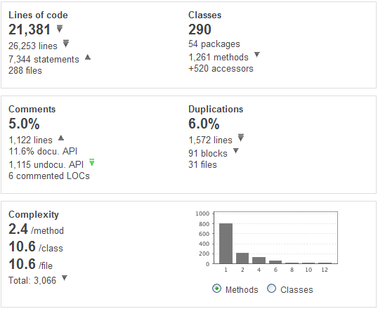
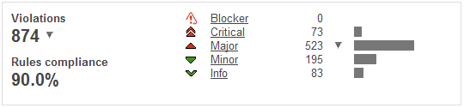
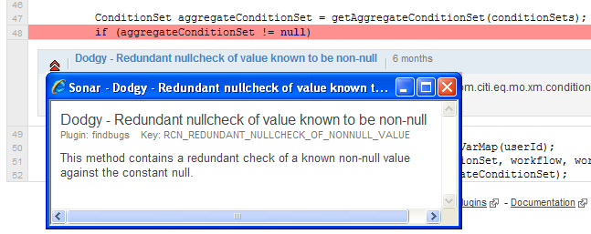
Static Code Analysis
Automated assessment of your codebase to determine
Common “bad practices”
Common coding errors
Program/Class/Method Complexity
Notes:
Static inspection tools can be used to run a number of rules on a code base.
SonarQube is an open software platform for continuous Inspection of code quality that is widely used within industry.
It runs on the code base and carries out a range of quality checks such as running quality rules, sending alerts, etc.
Sonar has over 100 rules of its own. You can use the FindBugs plugin which has nearly 400 rules to find potential Java errors.
Additional, you can write your own rules. We currently have over 100 of these.
Together all these rules are a powerful way of capturing errors and potential weaknesses in code as well as enforcing the coding standards of the company.

Slide 17
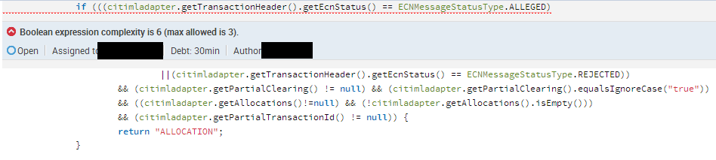
Static Inspection of Code Quality -Rules
You can use static tools to check coding practices such as Boolean Expression Complexity.
In this example the rule ‘Boolean expression complexity’ has been set to flag if there are more than three Booleans working together.
Notes:
I’ve created an example piece of code that breaks a rule, the ‘Boolean expression complexity’ rule.
There are no java errors here, put it is an example of a piece of code that is not cleanly written.
Over time, as code gets updated for projects and to fix bugs it can start to degrade and will need refactored.
Overly complex Boolean checks can be hard to read and are frequently the cause of wrong flows being taken, variables set, etc.
This could be broken up into:
A status check for Allocation flow.
Valid Allocations present
It is a Partial Clearing transaction

Slide 18
Coding Best Practice : In the trenches
In Practice
Aim to keep your best practices
Review best practices regularly
Remove any that do not benefit team
Add new ones that improve practices
Best Practice will not always be kept
Deadline pressures – excusable, but plan appropriately!
Lack of reinforcement – no excuses!
When best practice is not kept there needs to be a post release retrospective
Notes:
“Bad Practices”
“Magic Strings/Numbers” rather than use of constants
Ignoring Exceptions
“Common Coding Errors”
Failing to initialize
Unreachable code
“Complexity”
Good convention to have small “hit” methods, easier to review & test
Build complexity through layering of classes & methods
A multitude of nesting is increasingly hard to understand
Often forces novel, and more performant solutions

Slide 19
Coding Best Practice : When things go wrong
Project Retrospectives
What went right and what went wrong
Most importantly – Why did they go right or wrong
This should never be a blame game or nobody will be honest
Any lessons should be filtered back into the software process to try and ensure they are not repeated.
Typical outcomes from retrospectives
Poor upfront analysis
Lack of resources, whether time or manpower
Lack of communication, Lack of communication, Lack of communication.
Notes:
In practice time pressure will come into play when adhering to the Code Quality.
During times of higher pressure, a subset of these best practice may be deployed. But as a developer you should always be trying to include these. Its our job to make sure our code is of the highest quality possible.
When we do not adhere to best practice, then we need to examine why this did not happen and learn from these lessons.

Slide 20
Unit Testing

Slide 21
What is unit testing
“…The goal of unit testing is to isolate each part of the program and show that the individual parts are correct. A unit test provides a strict, written contract that the piece of code must satisfy…” (Kolawa, Adam; Huizinga, Dorota (2007)).
Testing of the smallest ‘units’ of code and their interaction with dependencies
Allows a narrow focus on testing
Assumption that if inidividual parts are correct the entire application is also
Written by developers
Requires working knowledge of the code and its purpose
An implicit part of the coding task
Should be code-based to remove manual error and permit repeat execution (though may be associated with an element of manual code review or ‘static testing’)
Notes:
Unit testing means the testing of the smallest ‘units’ of code – classes, methods (as opposed to larger scale integration, system, and functional testing)
Unit tests are written and run by software developers to ensure that code meets its design and behaves as intended.
Should be code-based to remove manual error and easily permit repeat execution (though may be associated with an element of manual code review or ‘static testing’

Slide 22
Why write unit tests?
The sooner an issue is found, the cheaper it is to fix.
e.g. detection during QA requires
Developer to confirm and fix the bug
Repeat Unit Testing, Integration testing & QA testing
Exponentially worse if it makes it into a release
Aids a software developer in thinking through a change, encouraging them to explore the possibilities and implications for the system from the changes they make.
Can help increase the modularity of software, as it’s easier to write unit tests when the software is well modularised.
“Regression” testing when future changes are made, helping detect accidental introduction of bugs
Notes:
The sooner issues are found, the cheaper they are to fix. Bugs detected in QA cycles or after release require much greater effort to fix (further QA testing, release effort, associated planning). If a major bug is found late in the QA cycle it can even jeopardise the release.
It helps the developer really think about what the change is meant to do. It forces the developer to nail down the requirements before doing any coding.
Can help increase the modularity of software. As a unit test is going to test one specific thing, it forces the developer to write functions that do one specific thing. This helps break the code up into sensibly sized pieces that are easier to maintain.
A base of automated unit tests can be re-used in future, helping detect accidental introduction of bugs

Slide 23
When & How to write Unit Tests
Make it an implicit part of the coding task – the code isn’t complete until it’s unit tested
Accept that some areas can’t be unit tested e.g. existing, tightly coupled code, but test what you can
Consider multiple test scenarios per unit
The “Happy Path” – when it all works as expected
Alternate paths through the code
Error/Exception Cases e.g. is a dependency throws an exception
Implement them using a unit testing framework, preferably one that integrates to your IDE
Test Driven Development advocates the writing of test code prior to the actual program code – you then code until all tests pass
Notes:
Continually. It’s not always possible to write unit tests for all sections of code, particularly those embedded within existing systems, however it should always be attempted and tests written whenever possible
Analyse the code required to meet a requirement. Decide which methods and classes may need to be created or modified to meet that requirement. Look at what the code should do, and the boundary conditions and error conditions it should handle. Formulate tests for the methods, and implement them using a unit testing framework, preferably one that integrates to your IDE
Test Driven Development advocates the writing of test code prior to the actual program code

Slide 24
Unit testing frameworks
There are many unit testing frameworks available – most popular are the XUnit family (JUnit, NUnit, CPPUnit, etc.)
It’s advisable to choose one that
is widely adopted
offers good IDE integration
has good references and support groups (email forums etc.) online

Slide 25
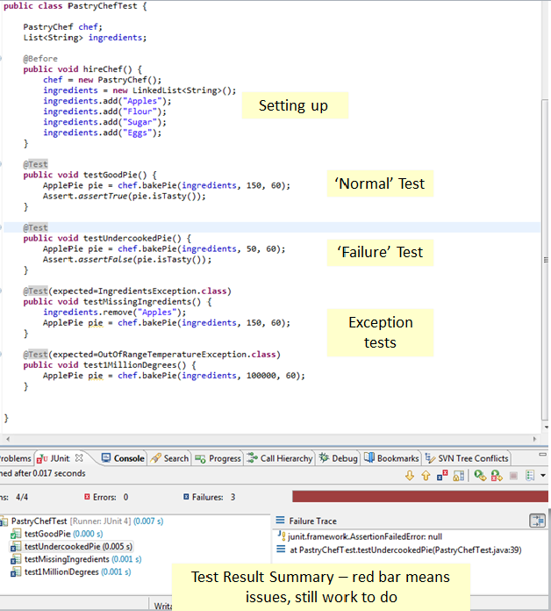
Example
Notes:
The concept of the Unit test is relatively simple.
You create your object and set it up.
This is annotated to be executed before the tests are run, @Before
We can then run tests on the methods of the object.
These can be ‘normal’ tests that we expect to pass.
‘Failure’ tests that we expect to fail.
‘Exception’ tests that we know will throw exceptions, e.g. out of limit tests.

Slide 26
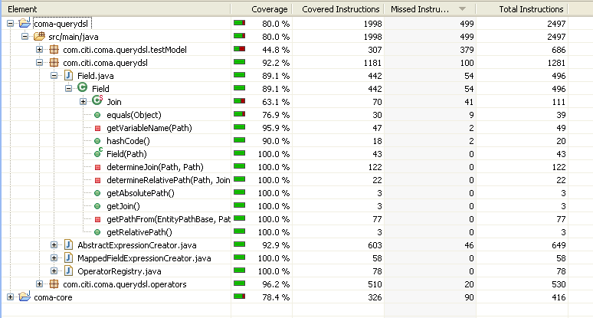
Code Coverage
Code coverage is ensuring that your unit testing tests all paths through each “unit”
Writing unit tests is definitely advised, but there’s little point in 1000’s of tests that focus on a small area to the exclusion of others
Notes:
You could write a unit test for a method and pat yourself on the back that the job is complete.
However, the method could have a number of paths within it.
e.g. a simple Boolean check will obviously have two paths. The Boolean being true and the Boolean being false.
It is important that we don’t kid ourselves about what the unit test is covering and lead ourselves into a false sense of security.
A static code coverage tool is an excellent, systematic way of checking what’s getting covered and what is not.

Slide 27
Continuous Integration

Slide 28
Recap on the Concepts of Building Software
In the software development phase of a project
A developer writes software code in a programming language, e.g. Java
For this code to be useful, a few things have to happen
It has to be compiled
It has to be tested and pass those tests
It has to be packaged for distribution
So… the developer needs some tools at his/her disposal to do this application building
Notes:
In order to put software build into context, lets look at the steps a developer needs to go through to turn lines of code in a program into something a bit more useful – remember we’re dealing with a language that requires a compiler.
For that code to actually do something, it has to be compiled into a form the machine can understand and execute, verifying it for correctness against language rules at the same time.
It should be tested through a set of pre-written unit tests – these tests should exercise a defined number of scenarios referred to as ‘test cases’ – situations we expect our code to handle in a controlled way – both ‘happy path’ and exceptional situations. Typically as a software project grows and more code is added to it, the number of test cases increases, leading to more unit tests being added to the suite of tests.

Slide 29
Definitions
So, what is Continuous Integration?
A tool that helps improve software quality, build and deployment by:
Removing all manual steps in building software
Detecting build breaks sooner with targeted communications
Reporting failing tests more clearly
Automating the process of deployment
Increasing the visibility of progress
Producing metrics on code quality and test coverage
And more..
A recognised and widely used industry-standard approach to software development
Notes:
CI can monitor your software configuration management tool for changes to the software in your project. When a change occurs CI can kick in and build your entire software project, not just the class you’ve changed. It can also run all your test cases after the software has been built (this is the recommended approach). In fact, it’s common practice at Google for the unit tests to run whenever a developer even saves their code.
As it builds the whole project and runs all the unit tests, it can detect failures quickly and let the team know right away. You’ve got a much better handle therefore on the health of your code and a good indicator for where your project is at – on target? slipping behind schedule? Forewarned is forearmed.
As all tests are run, code is being continually tested to validate it for integrity and coherence.
But CI can go beyond simply building your code and running your tests (although arguably these are its USP). You can use CI to monitor the actual quality of the code you write, delivering metrics to you, telling you about issues with that class you wrote the other day or that variable you declared but never used. All this can help you focus in on areas of concern and fix them. It can also tell you how much of your code is covered by unit tests and more importantly, how much isn’t. Code that isn’t covered by a unit test could conceivably harbour an unexpected bug that causes an error when your project finally makes its way to production and is being used ‘for real’ – this isn’t when you want that bug to be unearthed! As you can appreciate, quality of testing is very much dependent on your test coverage, in other words, how much of the code is covered by tests and also how much of the original requirement is covered by tests.
CI is all about reducing the risk of developing software. Software today is more complex than it’s ever been so we need all the help we can get!

Slide 30
Phases to Implementing
Moving from zero to hero in CI
Phase 1 – You’ve no build server, you build manually
Phase 2 – Nightly builds, you’ve a build server that simply compiles the code
Phase 3 – Nightly builds and automated tests, you’re compiling and running a set of automated tests
Phase 4 – Enter the metrics, automated code quality and code coverage metrics are added to the mix
Phase 5 and beyond – automated deployment, running acceptance tests and finally continuous deployment
Notes:
Typically when an organisation is looking to implement CI – be it a business or an educational institution – there are some phases they’ll pass through.
They will start by building their code in a manual way – if they use Ant then great but they’re missing out some of the features that CI could give them so first thing after installing a CI tool is to set up the build server that’s actually going to run the builds and create a build job on that server. That build job will be executing the Ant build script, usually people start off by doing this nightly.
Then they introduce the automated tests. If Ant was already running the tests (as you spent time writing them), even better, now they’ll get run every time the CI job kicks in.
The frequency of the CI job is a matter of choice – nightly, every minute, every hour, when there’s a check-in into the source code repository. CI is flexible so you need to go for the frequency that works for you and your project.
After just building and running the tests, you can move into metrics capture, source code quality analysis, test coverage onto even automated deployment of packaged code into production.

Slide 31
Simple steps to getting started
Simple steps to Continuous Integration
Use a version management tool to manage your software project
Use an Ant build script that compiles and builds your software
Use a CI tool such as Jenkins
Create a CI job which executes your Ant build script
Give the job a schedule or triggering event
Are there any actions you want to perform after the software has built?
How do you want to be kept informed of the status of builds?
What do you want to happen if a build fails?
Got any unit tests? Execute them and create a report of results
You could also extend to capture code quality metrics
Notes:
So just to recap in layman’s terms, these are the typical steps to follow to getting CI up and running.
Use an source code management tool like Subversion
Use Ant for building the source
Use a dedicated CI tool like Jenkins (others are available)
Create a job in CI for your project – the job will run your Ant script, tell it how often you want it to run or what will trigger the run, tell it what you want to happen after the Ant script has completed, how you want to be informed of the status of builds and what you want to happen if a build fails for any reason – obviously run the tests if you have tests (hopefully you have).
What next? Code quality metrics?

Slide 32
The Psychology of CI
What do you get out of Continuous Integration
More than a tool, it’s a mind-set
Fixing broken builds should take priority. Team members are incentivised to fix them for the greater good of the team
Communication is improved, publishing a clear picture of the current state of development
It’s about reducing risk by providing faster feedback to the team and those outside your team
It fosters collaborative problem solving and process improvement
Publicly-visible code quality metrics encourage you to take pride in the quality of your work and strive to improve
Notes:
So, as a developer, what do you get from CI?
From my experience it changes the way you think about software development. It focuses the mind more on quality of your code as breaks in the build are highlighted quickly and people generally strive to address issues like that much quicker, fostering a more team-based approach to quality.
It’s easy to get a concise view of the health of your project – it’s transparent, nothing is hidden – as they say “sunlight is the best disinfectant” and as nothing is hidden, risks to the project should be reduced as the team will be addressing issues brought up by CI.
It encourages the team to work together to resolve problems and as multiple teams can be using the same CI server, information about your project can be made visible to other teams. If your project is in a good state, you can take pride in that and improve further. What if another team has a problem, highlighted through CI? Well, maybe you can help with that.

Slide 33
Questions

Slide 34
References
http://www.wikipedia.com
http://subversion.apache.org
http://subclipse.tigris.org
http://www.extremeprogramming.org/rules/unittests.html
http://en.wikipedia.org/wiki/List_of_unit_testing_frameworks
Kolawa, Adam; Huizinga, Dorota (2007). Automated Defect Prevention: Best Practices in Software Management. Wiley-IEEE Computer Society Press. p. 426. ISBN 0-470-04212-5.

Slide 35
Code Review References
JAVA Code Review Check List
http://www.ttc.edu.vn/download/materials/Softwareengineering/Implementation/Java CheckList.doc
.NET 4.0
http://msdn.microsoft.com/en-us/library/ms229042.aspx
Google C++ Style Guide
http://google-styleguide.googlecode.com/svn/trunk/cppguide.xml

Slide 36
Code Review References (continued)
Recommended C Style and Coding Standards
http://www.doc.ic.ac.uk/lab/cplus/cstyle.html
PHP Coding Guidelines
http://www.phpdeveloper.org.uk/articles/php-coding-guidelines/
Google JavaScript Style Guide
http://google-styleguide.googlecode.com/svn/trunk/javascriptguide.xml
All Google Standards (includes CPP, C, python, java, java script, JSON, objectC, XML
http://google-styleguide.googlecode.com/svn/trunk/

